Slide 1
Plant Identification and Rangeland Management Techniqes
Hello everyone! My name is Ashley Tullis I am a So. Utah native and my major is in Ag. Science with an emphasis in Rangeland Management and Natural Resource Management

Slide 2
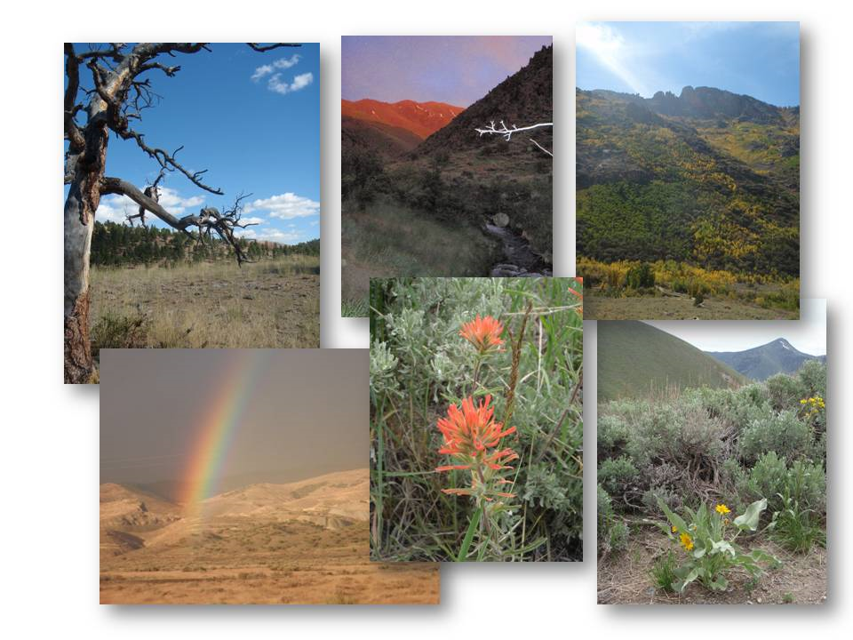
For my EDGE project I will be assisting Professor Violet with collecting and identifying native plant specimens for the purpose of updating SUU’s plant herbarium to ensure our Rangeland students are on the cutting edge of plant ID. Along with this I will also be taking part in Rangeland restoration projects and events that reach out to youth who are interested in this type of career.

Slide 3
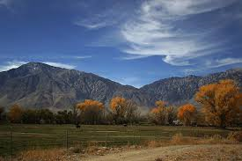
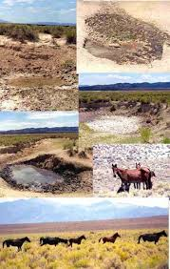
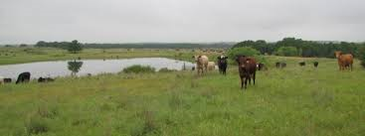
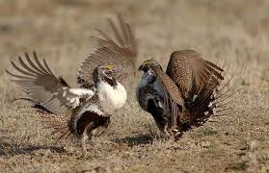
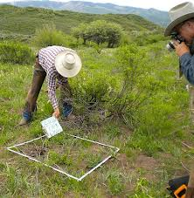
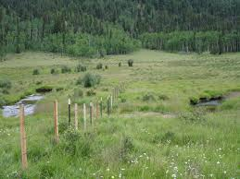
I chose this project because it gives me first hand experience in my future degree and career. My project will take place near Cedar City in Spring 2015. The funding for this project will come from grants and donations.

